Slide 1
Hemorrhoids

Slide 2
Contents
Introduction
Epidemiology
Rectal anatomy
How hemorrhoids develop?
Position of hemorrhoids
Causes
Diagnosis
Detailed patient history
Physical examination
Symptoms
Types of hemorrhoids
External hemorrhoids
Internal hemorrhoids
Stratification of internal hemorrhoids according to the severity of prolase
Grading of internal hemorrhoids
A range of treatments
Conservative treatment
Phlebotonics in Hemorrhoids (Diosmin)
Office based treatment (Rubber band ligation, Infrared photocoagulation and Sclerotherapy)
Surgery (Excisional surgical hemorrhoidectomy, Doppler guided hemorrhoidal artery ligation, Stapled hemorrhoidectomy)
Post operative pain
Post procedural care
No BEST treatment
Patients with compounding conditions
Algorithm for hemorrhoid management
Take home message
Thank you

Slide 3
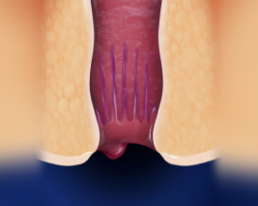
Introduction
Hemorrhoids are distal prolapse of arteriovenous bundle, muscle fibers, and surrounding connective tissue as an envelope below dentate line in anal canal.
Usually present with painless rectal bleeding.
Common reason for office visits.
Each patient is unique and treatment can be individualized according to every patients need.
Am Fam Physician. 2018;97(3):172-179

Slide 4

Epidemiology
More prevalent in persons 45 to 65 years of age.
Accounted for more than 3.5 million US outpatient visits in 2010.
Third leading cause of hospital admissions related to gastrointestinal disease.
Exact prevalence is unknown because most patients are asymptomatic and do not seek care from a physician.
Study of patients undergoing routine colorectal cancer screening found a 39% prevalence of hemorrhoids, with 55% of those patients reporting no symptoms.
Am Fam Physician. 2018;97(3):172-179

Slide 5
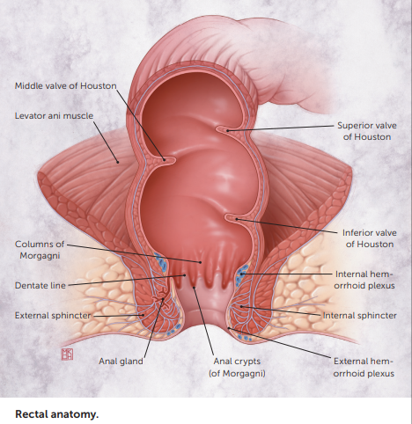
Rectal anatomy

Slide 6
How hemorrhoids develop?
When the venous drainage of the anus is altered it cause venous plexus and connecting tissue to dilate, creating an outgrowth of anal mucosa from the rectal wall.
But the exact pathophysiology is still unknown.
Am Fam Physician. 2018;97(3):172-179

Slide 7
Position of hemorrhoids
Occur above or below the dentate line where proximal columnar transitions to distal squamous epithelium.
Anus is approx. 4 cm long in adults, with the dentate line located roughly at the midpoint.
Hemorrhoids developing above the dentate line are internal and painless because they are viscerally innervated.
External hemorrhoids develop below the dentate line and can become painful when swollen.
Notes:
Extent of prolapse of internal hemorrhoids can be graded on a scale from I to IV, which guides effective treatment (Figure 2).
ØThis grading system is incomplete, however, because it focuses exclusively on the extent of prolapse and does not consider other clinical factors, such as size and number of hemorrhoids, amount of pain and bleeding, and patient comorbidities and preferences.

Slide 8
Causes
Increase pressure in hemorrhoidal venous plexus and other associated conditions, such as
Straining during bowel movements secondary to constipation
Obesity
Pregnancy
Chronic diarrhea
Anal intercourse
Cirrhosis with ascites
Pelvic floor dysfunction
Low-fiber diet
Increased consumption of processed foods
A sedentary lifestyle
Using cell phones while defecating which translates to much more time spent on the toilet
Am Fam Physician. 2018;97(3):172-179

Slide 9

Diagnosis

Slide 10
Diagnosis
Diagnosis of hemorrhoids relies on the
  History and
  Physical examination rather than on laboratory testing or imaging studies.
Because patients often attribute any anorectal symptom to hemorrhoids when there may be another reason

Slide 11
Detailed patient history
Should include
  extent, severity, and duration of symptoms
  frequency of bowel movements
  associated symptoms (eg, constipation, fecal incontinence),
  daily dietary habits
  details of bowel movements (eg, time spent during each bowel movement and concomitant cell phone use)
Note: Some patients experience lifelong constipation or diarrhea, therefore, what a patient considers a normal bowel habit may not be normal and should be investigated. Also, it is important to exclude external thrombosed hemorrhoids, anal fissure, anal abscess, and Crohn disease.

Slide 12
Physical examination
In addition to an abdominal examination, the perineal and rectal areas should be inspected with the patient at rest and while bearing down.
Patient can be in lateral decubitus, lithotomy, or prone jackknife position (i.e., patient prone with table adjusted so that hips are flexed, with head and feet at a lower level).
During the examination, look for
  skin tags,
  sphincter tone,
  perianal hygiene
  synchronous anal lesions
A digital rectal examination can detect masses, tenderness, and fluctuance, but internal hemorrhoids are less likely to be palpable unless they are large or prolapsed.

Slide 13
Physical examination
Presence of external hemorrhoids or prolapse of internal hemorrhoids may be obvious.
Anoscopy is an effective way to visualize internal hemorrhoids that look like purplish bulges through the anoscope.
Valsalva maneuver can be performed during the digital rectal examination.
Red flags for colorectal cancer on the digital rectal examination include a mass with or without presence of hemorrhoidal sacs and a bleeding source above the level of internal hemorrhoids.
Patients with recurrent abscesses, fistulas, or skin tags (especially cauliflower-type skin tags) should be investigated for Crohn disease.

Slide 14
Physical examination
Note:
Physicians should avoid use of clock face terms to describe lesions, because the position of the patient can vary.
Instead, he/she should use terms relative to the patient, such as anterior, posterior, left, or right.
Typically, hemorrhoids develop on anatomic planes, or hemorrhoidal columns, in the left lateral, right anterior, or right posterior aspect of the anus.

Slide 15
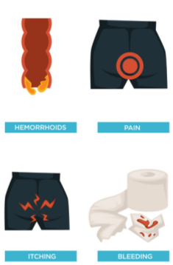
Symptoms
Typically, the presenting symptom is painless rectal bleeding associated with bowel movements, usually appearing as bright red blood on the toilet paper or coating the stool.
Severe itching and anal discomfort are also common, especially with chronic hemorrhoids.
Am Fam Physician. 2018;97(3):172-179

Slide 16
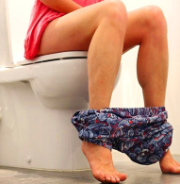
Types of hemorrhoids

Slide 17
Types of hemorrhoids
Classification of a hemorrhoid corresponds to its position relative to the dentate line.
Hemorrhoids can be categorized as either:
  External
  Internal

Slide 18
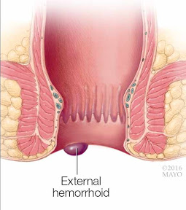
External hemorrhoids
Located below the dentate line
Develop from ectoderm embryonically
Covered with anoderm, composed of squamous epithelium
Innervated by somatic nerves supplying perianal skin and thus produce pain
Vascular outflows of external hemorrhoids are via inferior rectal veins into pudendal vessels and then into internal iliac veins
Clin Colon Rectal Surg. 2016;29(1):22‐29.

Slide 19
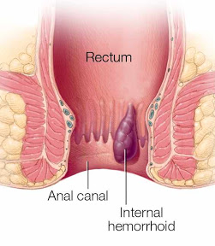
Internal hemorrhoids
Lie above the dentate line
Derived from endoderm
Covered with rectal columnar and transitional mucosa
Innervated by visceral nerve fibers, thus cannot cause pain
Vascular outflows of internal hemorrhoids include middle and superior rectal veins, which subsequently drain into internal iliac vessels
Clin Colon Rectal Surg. 2016;29(1):22‐29.

Slide 20
Stratification of internal hemorrhoids depending on the severity of prolapse
Gradation on a 4-point scale
  Grade I—Visible hemorrhoids that do not prolapse
  Grade II—Hemorrhoids that prolapse during the Valsalva maneuver but spontaneously reduce
  Grade III—Hemorrhoids that prolapse during the Valsalva maneuver and need manual reduction
  Grade IV—Non-reducible hemorrhoids
Clin Colon Rectal Surg. 2016;29(1):22‐29.

Slide 21
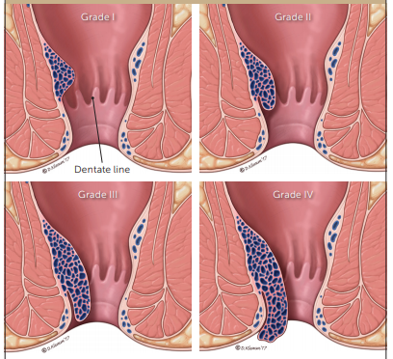
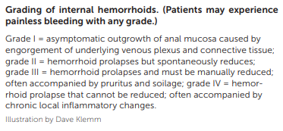
Grading of internal hemorrhoids

Slide 22
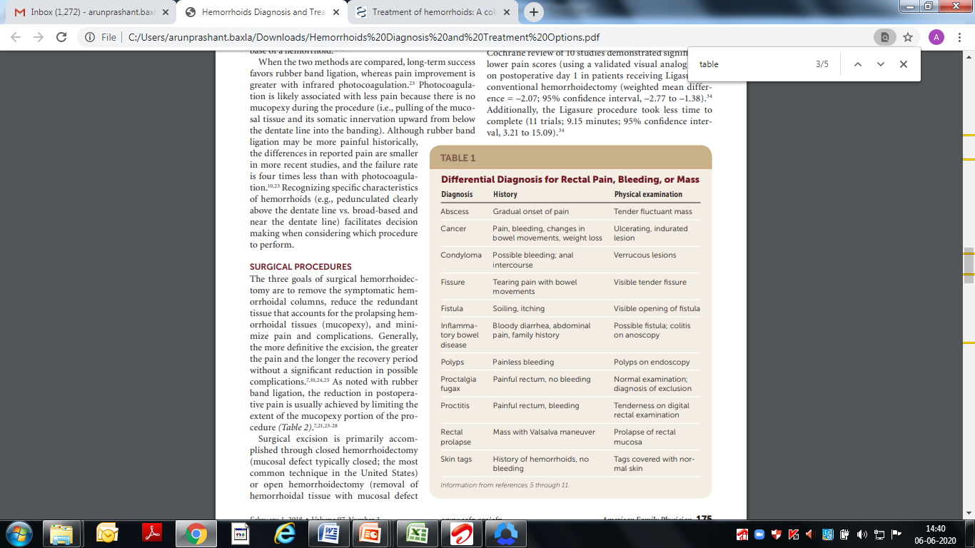
Differential Diagnosis for Rectal Pain, Bleeding, or Mass

Slide 23

Treatment

Slide 24
A range of treatments
For choosing the treatment for hemorrhoids, several points needs to be considered like:
  Disease grade and severity
  Impact on the quality of life
  Degree of pain it causes
  Patient’s likelihood of adhering to treatment
  Patient’s personal preference.
Regardless of severity, treatment almost always starts with
  a high-fiber diet
  other lifestyle modifications that include bowel movement behaviors
}
Requires practitioners to spend significant time on patient education

Slide 25
A range of treatments
Treatments can be grouped in 3 categories:
Conservative
Office-based
Surgical
Note: Treatment options should thoroughly be discussed with the patients, emphasizing the pros and cons of each

Slide 26

Conservative treatment

Slide 27
Conservative treatment
Conservative therapy is considered first-line treatment for symptomatic hemorrhoids.
Aim of the conservative treatment is
  softening the stool
  relieving pain
  correcting bad toileting habits
Notes:
In most cases, primary precipitating factor is lifestyle, & unless patients change it, they are more likely to have recurrent symptoms in long term.
Therefore, lifestyle and dietary modification are mainstays of conservative medical treatment of hemorrhoid disease.

Slide 28
Conservative treatment options
Increasing fibre intake to >25 g/day - decreases the shearing action of passing hard stool.
Fibre supplementation with psyllium, sterculia, or unprocessed bran decreased bleeding, pain, prolapse, and itching
According to a meta-analysis of 7 randomized trials comparing fiber to nonfiber controls, fiber supplementation (7–20 g/d) reduced risk of persisting symptoms and bleeding by 50%. However, fiber intake did not improve symptoms of prolapse, pain, and itching.
Indian Journal of Clinical Practice, Vol. 25, No. 6, November 2014

Slide 29
Conservative treatment options
Together with increasing liquid intake, minimizing time on the toilet and evacuating soon after feeling the urge, these interventions are aimed at minimizing constipation and straining.
Sitz bath (bathing in warm water) has a soothing effect on anal discomfort (review of studies found no benefit for various anorectal disorders, including hemorrhoids).
Use of stool softeners - Polyethylene glycol is an osmotic laxative that softens stool by increasing the water content of stool.
Indian Journal of Clinical Practice, Vol. 25, No. 6, November 2014

Slide 30
Conservative treatment options
Supplements containing bioflavonoids e.g., diosmin, hesperidin, rutosides or venotonic agents, diosmin (a flavonoid), used in addition to other measures may decrease bleeding, pruritus, and fecal leakage, as well as improve overall symptoms. Venotonic injection at hemorrhoidal site is also possible but has a poor outcome. Also these bioflavonoids are not approved by U.S. FDA for hemorrhoid treatment.
Diosmin amongst flavonoids are the most well evidenced and studied in the medical management of hemorrhoids .
Synthetic drugs like calcium dobesilate too are used in hemorrhoids
For quick relief of symptoms topical agents containing local anesthetics, steroids, astringents and/or antiseptics may be satisfactory, but prolonged application may induce maceration and allergy.
https://www.ncbi.nlm.nih.gov/books/NBK500009/

Slide 31
Conservative treatment options
Over the counter remedies may provide temporary relief, but long term safety and efficacy is not known e.g. protectants (zinc oxide), decongestants (phenylephrine).
Prescription therapies may also be part of firstline treatment e.g. topical nitroglycerin as a 0.4% ointment decreases rectal pain caused by thrombosed hemorrhoids, although is more commonly used for anal fissures, topical nifedipine also is effective for pain relief, single injection of botulinum toxin into anal sphincter effectively decreases pain of thrombosed external hemorrhoids.
Conservative management is sufficient to improve or resolve symptoms in many patients

Slide 32
Phlebotonics in Hemorrhoid
Widely used in the medical management
Supportive therapy with office and surgical procedures
Flavonoids are the most common phlebotonic agent used for treating hemorrhoids.
Flavonoids could increase vascular tone, reduce venous capacity, decrease capillary permeability, facilitate lymphatic drainage and has anti-inflammatory. effects
A large meta-analysis of phlebotonics for hemorrhoids in 2012 showed that phlebotonics had significant beneficial effects on bleeding, pruritus, discharge and overall symptom improvement.
Phlebotonics also alleviated post-hemorrhoidectomy symptoms
Diosmin is one of the most well studied in clinical trials

Slide 33
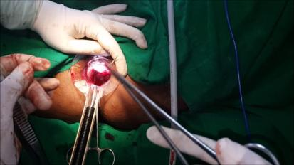
b) Office-based treatments

Slide 34
Office based treatments
Commonly used office-based treatments are
  Rubber band ligation
  Infrared photocoagulation
  Sclerotherapy
Primary goal is to decrease blood flow into hemorrhoidal sac
}
Used for grade I, II, and III hemorrhoids that have not responded to conservative management or refractory to medical therapies.
Notes:
Office-based and surgical procedures can effectively treat hemorrhoids refractory to medical therapies. In general, the lower the grade, the more likely an office-based procedure will be successful, whereas recurring and grade III or IV hemorrhoids are more amenable to excisional hemorrhoidectomy.
Thrombosed external hemorrhoids can be extremely painful. Although conservative management with topical therapies is reasonable, surgical removal of the thrombus within the first two to three days leads to quicker symptom resolution, lower risk of recurrence, and a prolonged recurrence interval.11,19-22 This procedure has been previously described in American Family Physician. 22

Slide 35
Office based treatments
Highly effective and major complications are uncommon
Recurrence rates can be high, requiring patients to undergo additional treatments
Septic complications can occur, so patients should be closely observed for fever and urinary problems
Pain is common after this procedure & bleeding may also occur
The ASCRS guidelines strongly recommend office-based treatments for patients with grade I and II hemorrhoids and for some with grade III hemorrhoids

Slide 36
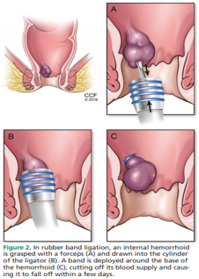
Rubber band ligation
Ligating apex of hemorrhoidal cushion stops arterial flow & causes hemorrhoidal tissue to undergo ischemic necrosis & a virtual mucopexy occurs.
Performed above dentate line, where sensory nerve fibers differ from those found below the line, therefore, causes less pain than one would expect.
One or more hemorrhoidal cushions can be ligated at same time, though associated with increased pain, bleeding & vasomotor reactions.
Am Fam Physician. 2018;97(3):172-179
Notes:
A ligation instrument is inserted through a speculum to grasp or suction the targeted hemorrhoid to facilitate placement of a rubber band over the hemorrhoid down to its pedicle. The hemorrhoid ischemically necroses, and a virtual mucopexy occurs as the anal mucosa is pulled upward and the necrotic base puckers mucosa together, effectively elevating the more inferior anal mucosa.

Slide 37
Rubber band ligation
Study:
Patients on warfarin therapy and aspirin had up to a 9 and 3 times higher risk of postprocedural bleeding respectively (Iyer et al). Note: it is unclear whether this procedure can be used in patients on anticoagulant therapy.
Cochrane database review - Effective for hemorrhoid grades I through III (Grade III hemorrhoids patients may benefit more from excisional hemorrhoidectomy, with lower recurrence rate than rubber band ligation).
RCT comparing hemorrhoidal artery ligation & rubber band ligation for symptomatic hemorrhoids in grade II and III hemorrhoids - Postprocedural pain scores on days 1 & 7 were significantly lower with rubber band ligation, but recurrences were more common (49% vs 30% respectively) - (Brown et al)
Overall, rubber band ligation is an excellent option for grade II hemorrhoids as it is easy to perform, associated with low pain scores & can be used to treat recurrences.

Slide 38
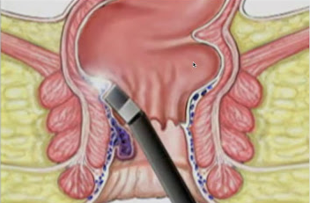
b) Infrared photocoagulation
An infrared probe produces heat to induce coagulation, fibrosis, and ultimately necrosis of the protruding tissue in the hemorrhoidal cushions.
Likely associated with less pain because there is no mucopexy (i.e., pulling of mucosal tissue & its somatic innervation upward from below dentate line into banding).
Though its use was initially directed at grade I and II hemorrhoids, recent reports showed acceptable results for grades III and IV.
Am Fam Physician. 2018;97(3):172-179
Notes:
Infrared photocoagulation similarly stimulates necrosis to the proximal base of a hemorrhoid. Photocoagulation is likely associated with less pain because there is no mucopexy during the procedure (i.e., pulling of the mucosal tissue and its somatic innervation upward from below the dentate line into the banding).

Slide 39
b) Infrared photocoagulation
Study:
RCT comparing infrared photocoagulation and rubber band ligation in 94 patients - both procedures were well accepted & highly effective but better pain scores were obtained with photocoagulation in the first 24 hrs after procedure.
Am Fam Physician. 2018;97(3):172-179
Notes:
Infrared photocoagulation similarly stimulates necrosis to the proximal base of a hemorrhoid. Photocoagulation is likely associated with less pain because there is no mucopexy during the procedure (i.e., pulling of the mucosal tissue and its somatic innervation upward from below the dentate line into the banding).

Slide 40
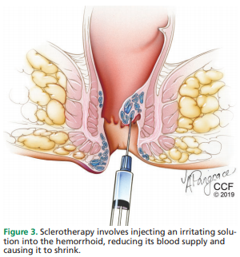
c) Sclerotherapy
Involves injection of a sclerotic agent into the submucosa of hemorrhoidal sac
Causes an inflammatory reaction and eventually forms fibrotic tissue that stops blood flow to the hemorrhoid.
Many sclerotic agents are available, including 5% phenol in almond or vegetable oil, quinine, ethanolamine, and hypertonic saline.
Am Fam Physician. 2018;97(3):172-179

Slide 41
c) Sclerotherapy
Side effects:
Injection can cause prostatic abscess and sepsis, although this is rare.
Nevertheless, high fever and postprocedural pain should be carefully evaluated.
Study:
From a few randomized trials of sclerotherapy, success rates so far have been higher for grade I hemorrhoids than for grades II and III.
Preferred method for patients who have bleeding abnormalities caused by medications or other diseases (eg, cirrhosis).
Am Fam Physician. 2018;97(3):172-179

Slide 42

c) Surgery

Slide 43
Surgery
Most effective and strongly recommended treatment for patients with high-grade internal hemorrhoids (grades III and IV), external and mixed hemorrhoids, and recurrent hemorrhoids.
Three goals of surgical hemorrhoidectomy are
  to remove the symptomatic hemorrhoidal columns
  reduce the redundant tissue that accounts for the prolapsing hemorrhoidal tissues (mucopexy)
  minimize pain and complications
Am Fam Physician. 2018;97(3):172-179
Notes:
SURGICAL PROCEDURES The three goals of surgical hemorrhoidectomy are to remove the symptomatic hemorrhoidal columns, reduce the redundant tissue that accounts for the prolapsing hemorrhoidal tissues (mucopexy), and minimize pain and complications. Generally, the more definitive the excision, the greater the pain and the longer the recovery period without a significant reduction in possible complications.7,10,24,25 As noted with rubber band ligation, the reduction in postoperative pain is usually achieved by limiting the extent of the mucopexy portion of the procedure (Table 2). 7,21,23-28 Surgical excision is primarily accomplished through closed hemorrhoidectomy (mucosal defect typically closed; the most common technique in the United States) or open hemorrhoidectomy (removal of hemorrhoidal tissue with mucosal defect

Slide 44
Surgery
More definitive the excision, greater the pain and longer the recovery period without a significant reduction in possible complications and just like rubber band ligation reduction in postoperative pain is usually achieved by limiting the extent of the mucopexy portion of the procedure
Most popular surgical options are
  Open or closed hemorrhoidectomy
  Doppler-guided hemorrhoidal artery ligation
  Stapled hemorrhoidopexy
Each has different success rates and different complication profiles that should be discussed with the patient.
Notes:
SURGICAL PROCEDURES The three goals of surgical hemorrhoidectomy are to remove the symptomatic hemorrhoidal columns, reduce the redundant tissue that accounts for the prolapsing hemorrhoidal tissues (mucopexy), and minimize pain and complications. Generally, the more definitive the excision, the greater the pain and the longer the recovery period without a significant reduction in possible complications.7,10,24,25 As noted with rubber band ligation, the reduction in postoperative pain is usually achieved by limiting the extent of the mucopexy portion of the procedure (Table 2). 7,21,23-28 Surgical excision is primarily accomplished through closed hemorrhoidectomy (mucosal defect typically closed; the most common technique in the United States) or open hemorrhoidectomy (removal of hemorrhoidal tissue with mucosal defect

Slide 45
Surgery
Surgical procedures are more painful and associated with more blood loss and longer recovery time, but it has significantly lower rates of recurrence than office-based treatments or medical management.
Side effects:
Most commonly post operative pain
Anal stricture (rare) or incontinence may occur due to excessive tissue excision and damage to sphincter muscles (Damage can be avoided by maintaining normal anoderm between excisions, not excising all hemorrhoid sacs at once in extensive lesions and by performing a careful dissection in submucosal plane
Patients with profuse bleeding or an underlying bleeding abnormality are best managed with surgical approaches performed in an operating room.

Slide 46
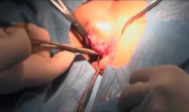
Excisional surgical hemorrhoidectomy
Excision of hemorrhoidal sac (most conventional surgical technique)
Most effective for recurrent, highly symptomatic grade III or IV hemorrhoids
Can be performed using either an
open approach, in which edges of mucosal defect are not reapproximated
closed approach, in which edges of mucosal defect are reapproximated
Recurrence rate after the procedure is significantly lower than with any other approach.

Slide 47
Excisional surgical hemorrhoidectomy
Study:
Systematic review by Bhatti et al compared open vs closed techniques
  closed technique resulted in less postoperative pain, better wound healing, and less bleeding
  rates of recurrence, postoperative complications, and surgical site infection and lengths of stay were comparable with either procedure
Overall, excisional hemorrhoidectomy is associated with higher pain scores, more blood loss and longer recovery time than any other surgical method.

Slide 48
Excisional surgical hemorrhoidectomy
Modified conventional hemorrhoidectomy include two alternative energy devices ligasure and harmonic scalpel which use diathermy and ultrasonic energy, respectively, to limit blood loss and postoperative pain as the instruments cut through tissue.
Cochrane review of 10 studies - significantly lower pain scores on postoperative day 1 in patients receiving Ligasure vs. conventional hemorrhoidectomy. Additionally, Ligasure procedure took less time to complete.
Notes:
These conventional techniques are the most effective for recurrent, highly symptomatic grade III or IV hemorrhoids. Compared with office-based procedures, conventional hemorrhoidectomy is more painful and associated with more blood loss and longer recovery time, but it has significantly lower rates of recurrence.7,23,26 Conventional hemorrhoidectomy has been modified to include two alternative energy devices, Ligasure and Harmonic Scalpel, which use diathermy and ultrasonic energy, respectively, to limit blood loss and postoperative pain as the instruments cut through tissue.32,33 A Cochrane review of 10 studies demonstrated significantly lower pain scores (using a validated visual analog scale) on postoperative day 1 in patients receiving Ligasure vs. conventional hemorrhoidectomy (weighted mean difference = –2.07; 95% confidence interval, –2.77 to –1.38).34 Additionally, the Ligasure procedure took less time to complete (11 trials; 9.15 minutes; 95% confidence interval, 3.21 to 15.09).34

Slide 49
b) Doppler-guided hemorrhoidal artery ligation
Involves using specialized lighted anal speculums with Doppler probes and/or suture ports to find and ligate superficial artery directly proximal to the associated hemorrhoid
Additionally, mucopexy (transanal rectoanal repair) may or may not be performed to relocate the prolapsing tissue
Study:
Avital et al reported that
At 1 year after this procedure, recurrence rates were 5.3% for grade II hemorrhoids and 13% for grade III hemorrhoids.
At 5 years, recurrence rates were 12% for grade II & 31% for grade III.
Notes:
Hemorrhoidal artery ligation, also known as transanal hemorrhoidal dearterialization, is a promising emerging therapy for grade II or III hemorrhoids.28 In this procedure, the superficial artery directly proximal to the associated hemorrhoid is isolated and ligated. Specialized lighted anal speculums with or without Doppler probes and/or suture ports have been developed to assist with this technique.
Early evidence suggests that hemorrhoidal artery ligation has similar outcomes to stapled hemorrhoidopexy with less postoperative pain.28,37 Hemorrhoidal artery ligation appears to have overall outcomes approaching those of conventional hemorrhoidectomy with similar postoperative pain.28,37

Slide 50
b) Doppler-guided hemorrhoidal artery ligation
Suitable for grade I, II, and III hemorrhoids, especially for grade II, but more studies are needed to prove its efficacy and recurrence rates for more advanced lesions.
Has high morbidity rate (18%), primarily pain or tenesmus, but causes less postoperative pain than other surgical methods.
Overall, it has the potential to become a favored treatment.

Slide 51
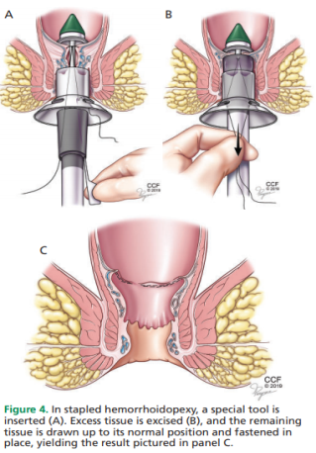
c) Stapled hemorrhoidopexy
Prolapsing part of internal hemorrhoidal cushion is moved upward by stapling rectal mucosa just above the hemorrhoid.
Not an option for patients with thrombosed internal hemorrhoids or with external hemorrhoids.
Pain scores are lower with stapled hemorrhoidopexy than with excisional hemorrhoidectomy, but not superior in terms of recurrences.
Notes:
Often referred to as stapled hemorrhoidectomy, which is a misnomer because the excised tissue is not the actual hemorrhoid, but rather loose proximal mucosa that has contributed to the prolapsed hemorrhoid. In this procedure, mucosal tissue 4 cm proximal to the dentate line is circumferentially removed and stapled so that the distal hemorrhoidal columns are effectively lifted back above the anal verge and attached to each other (mucopexy).

Slide 52
c) Stapled hemorrhoidopexy
Small but significant benefits with less time to first bowel movement, shorter hospital stays, and fewer unhealed wounds at four weeks.
Specific complications such as rectovaginal fistula, anal stenosis, or sphincter injuries may occur and these should be clearly explained to patients, and necessary information should be given to patients upon discharge.
Primary care physician should also be careful about fistulas and stenoses in this particular patient population.

Slide 53
c) Stapled hemorrhoidopexy
Study:
Cochrane review of 12 trials demonstrated - recurrent hemorrhoids were significantly more common after stapled hemorrhoidopexy vs. conventional excisional hemorrhoidectomy
A 2007 meta-analysis showed - no significant differences in complication rates between stapled hemorrhoidopexy vs. conventional excisional hemorrhoidectomy, with the exception of increased rates of persistence or recurrence of hemorrhoids and prolapse at one year of follow-up in patients who had stapled hemorrhoidopexy.
Notes:
Often referred to as stapled hemorrhoidectomy, which is a misnomer because the excised tissue is not the actual hemorrhoid, but rather loose proximal mucosa that has contributed to the prolapsed hemorrhoid. In this procedure, mucosal tissue 4 cm proximal to the dentate line is circumferentially removed and stapled so that the distal hemorrhoidal columns are effectively lifted back above the anal verge and attached to each other (mucopexy).

Slide 54
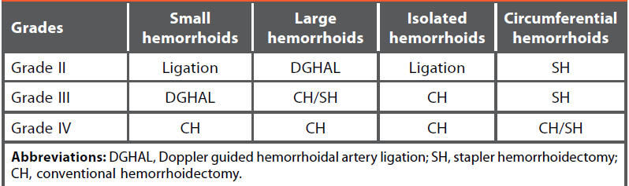
Preference for surgical options in hemorrhoids management
Yeo D, Tan K-Y. Hemorrhoidectomy – making sense of the surgical options. World J Gastroenterol. 2014;20(45):16976-83.

Slide 55

Patients with compounding conditions

Slide 56

Patients with compounding conditions
Pregnant patients
Often develop hemorrhoids as intra-abdominal pressure increases, particularly during the third trimester.
Acute episodes of pain and bleeding are common in pregnant women with preexisting hemorrhoids.

Slide 57
Patients with compounding conditions
Pregnant patients treatment of hemorrhoids
Conservative treatment - main approach in because most hemorrhoids regress after childbirth and include increased dietary fiber, stool softeners, and sitz baths, which are safe to use for external hemorrhoids.
Any office-based or surgical intervention should be postponed until after childbirth, if possible.
Kegel exercises and lying on the left side are also recommended to relieve symptoms.
In cases of severe bleeding, anal packing appears to be useful.

Slide 58

Patients with compounding conditions
Immunosuppressed patients and those on anticoagulant therapy
More prone to serious complications such as sepsis and profuse bleeding. Conservative management should be used.
Injection sclerotherapy may be beneficial, as it has been shown to decrease bleeding.
Note:
Patients on immunosuppressive agents should stop taking them and start taking an antibiotic
Patients on anticoagulant or antiplatelet medications should be instructed to stop them 1 week before any intervention

Slide 59
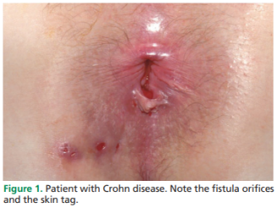
Patients with compounding conditions
Crohn disease
Some patients with Crohn disease may have hemorrhoids, though this is rare.
Study:
Eglinton et al reported that
Of 715 patients with Crohn disease, 190 (26.6%) had symptomatic perianal disease and of these, only 3 (1.6%) had hemorrhoids.

Slide 60
Patients with compounding conditions
Crohn disease treatment of hemorrhoids
Treatment is always conservative and directed at the Crohn disease rather than the hemorrhoids.
Note:
Patients with portal hypertension (eg, due to cirrhosis) are prone to have anorectal varices that may resemble hemorrhoids and these anorectal varices can be treated with vascular ligation, whereas sclerotherapy is preferred method for hemorrhoids in this group, in whom coagulopathy is common.

Slide 61

Post operative pain, complications and care

Slide 62

Postoperative pain
Postoperative pain has historically been universal with surgical hemorrhoidectomy.
Pudendal and anal blocks with local anesthetics have greatly reduced the amount of post hemorrhoidectomy pain.
Use of a lateral internal sphincterotomy in conjunction with conventional hemorrhoidectomy has also demonstrated a reduction in postoperative pain.

Slide 63
Post procedural complications
Discerning postoperative complications (e.g., abscess, proctitis) from anticipated symptoms can be challenging.
Pain and anal fullness expected within first week following hemorrhoidectomy or hemorrhoidopexy.
Common complications in early postoperative period except for pain - bleeding, urinary retention & thrombosed external hemorrhoids.
Rare but potentially life-threatening complications that must be identified early include abscess, sepsis, massive bleeding, and peritonitis.
Later postoperative period - recurrent hemorrhoids, anal stenosis, skin tags, late hemorrhage, constipation (often due to narcotic use), and fecal incontinence (Often lesser than in early postoperative period).

Slide 64

Post procedural care
Local medications are used to manage postoperative pain, with topical nitroglycerine ointment having the strongest evidence of effectiveness.
Postoperative injection of botulinum toxin as well as oral or topical metronidazole (Flagyl; Metrogel) are also options, although their effectiveness is disputed.

Slide 65

BEST Treatment

Slide 66

No ‘BEST’ treatment
There is no best treatment for hemorrhoids
Every patient is different
Physician and patient need to understand each other’s expectations, weigh risks and benefits and arrive at a mutual decision
Good patient doctor relationship is essential
Thorough history and physical examination is needed to understand the patient’s problem (Figure 5).

Slide 67
No ‘BEST’ treatment
Given variety of available treatments, head-to-head comparisons are difficult.
Efficacy and applicability of each technique changes with the grade of lesion or lesions and skill of the practitioner.
Lacking comprehensive studies comparing conservative, office-based, and surgical management, no decisive statements can be made based on current evidence.

Slide 68
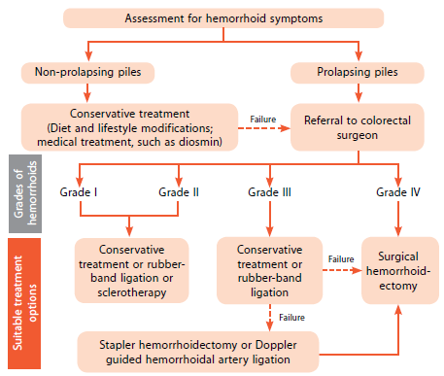
Algorithm for the management of hemorrhoids

Slide 69
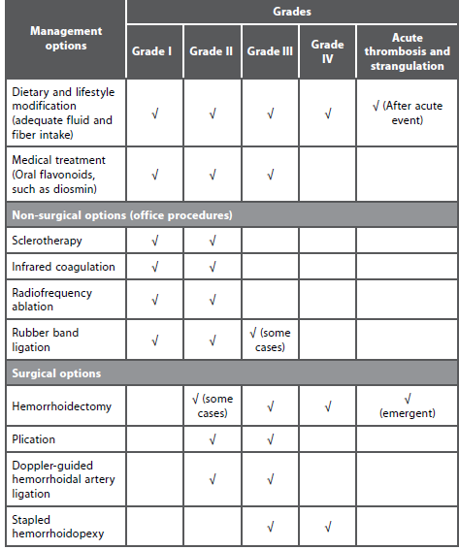
Summary of Management Options for Different Grades of Hemorrhoids

Slide 70

Take home messages
Hemorrhoidal disease is common in the United States, and with our diet and lifestyle, the incidence is likely to increase.
According to national survey found that overall dietary quality improved modestly in children and adolescents in the United States from 1999 to 2012 but remained far below optimal.
Careful assessment is needed for hemorrhoidal symptoms and complete any necessary screening tests before establishing a diagnosis. This helps to avoid missing any underlying disease.

Slide 71
Take home messages
Fiber supplements along with dietary and lifestyle changes constitute the baseline of the management regardless of the disease grade.
Phlebotonics are widely used in the medical management of hemorrhoids .
Diosmin is one of the phlebotonics which has been widely studied in the management of Hemorrhoids
Office-based interventions are beneficial for grade I and II hemorrhoids and for some grade III hemorrhoids. Repeated interventions can increase the success rate.
In patients with high-grade, symptomatic hemorrhoids, surgical hemorrhoidectomy is the most effective modality with the lowest recurrence rates, although it causes more pain than conservative methods.

Slide 72
THANK YOU!!!

